Slide 1
Data Science Course
Lecture 13

Slide 2
Intro
Quantative response Y.
p different predictors X1, X2, X3, …, Xp.
Some relationship between Y and X = (X1, X2, X3, …, Xp).
Y = f(X) + ϵ

Slide 3
Intro
f: in general an unknown function.
ϵ: random error term (independent of X).
We must estimate f based on the observed points.
f may involve more than one input variable.

Slide 4
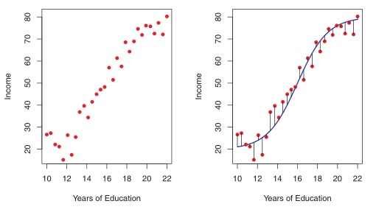

Slide 5
Machine what?
In essence, machine learning refers to a set of approaches for estimating f.

Slide 6
Why estimate f?
Predictions
We can predict Y using: Y hat = f hat (X)
F hat: our estimate of f.
Y hat: resulting prediction for Y.

Slide 7
Why estimate f?
The accuracy of Y hat as a prediction for Y depends on two quantities:
Reducible error.
Irreducible error.

Slide 8
How do we estimate f?
n data points.
xij represent the value of the jth predictor, or input, for observation i, where i = 1,2,...,n and j = 1,2,...,p.
Let yi represent the response variable for the ith observation.
Training data consist of {(x1, y1), (x2 , y2 ),..., (xn , yn )} where x i = (xi1, xi2 ,...,xip )T

Slide 9
How do we estimate f?
n data points.
xij represent the value of the jth predictor, or input, for observation i, where i = 1,2,...,n and j = 1,2,...,p.
Let yi represent the response variable for the ith observation.
Training data consist of {(x1, y1), (x2 , y2 ),..., (xn , yn )} where x i = (xi1, xi2 ,...,xip )T

Slide 10
How do we estimate f?
Our goal is to apply a learning method to the training data in order to estimate the unknown function f.
Find a function f hat such that Y ≈ f hat(X) for any observation (X, Y).

Slide 11
Parametric Methods
Two-step model-based approach:
1- First, we make an assumption about the functional form, or shape, of f.
2- After a model has been selected, we need a procedure that uses the training data to fit or train the model.
Examples: Linear regression, Logistic regression, Simple neural network, Naive bayes.

Slide 12
Non parametric Methods
Do not make explicit assumptions about the functional form of f.
Pros: Potential to accurately fit a wider range of possible shapes for f.
Cons: a very large number of observations (far more than is typically needed for a parametric approach) is required in order to obtain an accurate estimate for f.
Examples: KNN, Decision trees, SVM.

Slide 13

Measuring the Quality of Fit

Slide 14
Bias / variance trade off.
As model flexibility increases: training MSE? test MSE?.
Variance: amount by which f hat would change if we estimated it using a different training data set.
Bias: error that is introduced by approximating a real-life problem, which may be extremely complicated, by a much simpler model.
As a general rule, as we use more flexible methods, the variance will increase and the bias will decrease.

Slide 15
K-Nearest Neighbors
First identifies the K-points in the training data that are closest.
The choice of K has a drastic effect.
No learning is required.
Rescale data / missing data.

Slide 16

Linear Regression
It assumes that there is approximately a linear relationship between X and Y.
Coefficients are unknown.

